Slide 1


NBA Game Analysis
Group 20 (Lucasports)
Benjamin Wang, I-Kai Teng,
Yu-Hsi Chen, Po-Hsun Chiu
B

Slide 2


Introduction
Why Data Analysis is important to Sports?
Our Goal
Brief Into about NBA

Slide 3
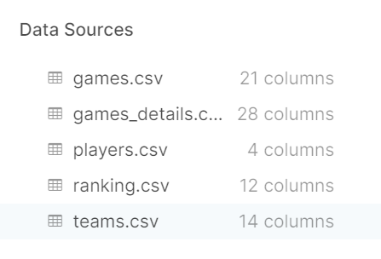
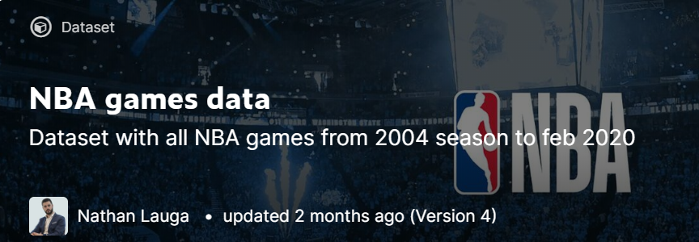
Data Acquisition
https://www.kaggle.com/nathanlauga/nba-games#games.csv

Slide 4
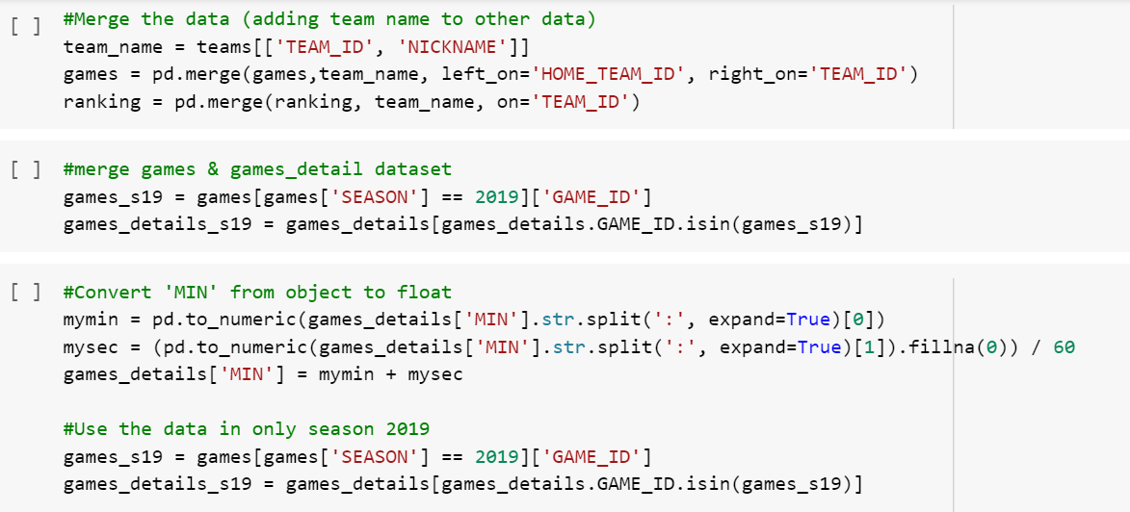
Data Cleaning

Slide 5
Analysis on Players’ Statistics and Other Information

Slide 6
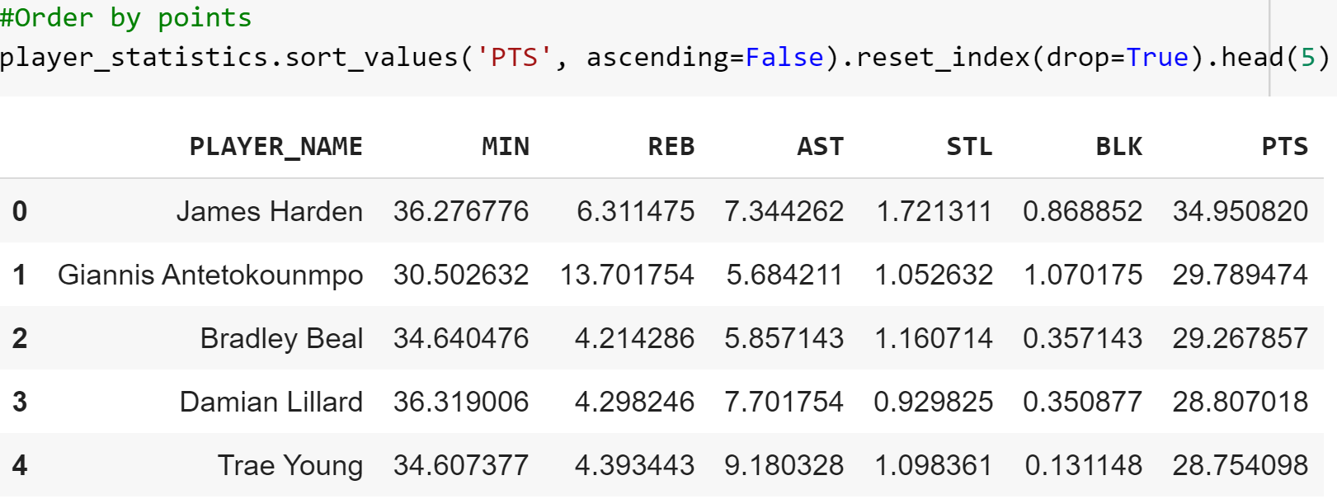
Ranking by Average Points

Slide 7
Is there a better benchmark?
Yes, there is.
Its called EFF.
EFF also known as efficiency.
EFF=(Points+Rebounds+Assists+Steals+Blocked-Missed field goals-Missed free throws-Turnovers)/Games played.

Slide 8
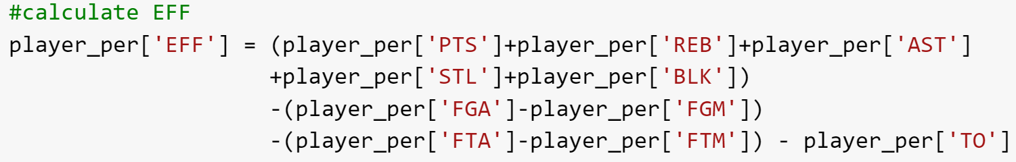
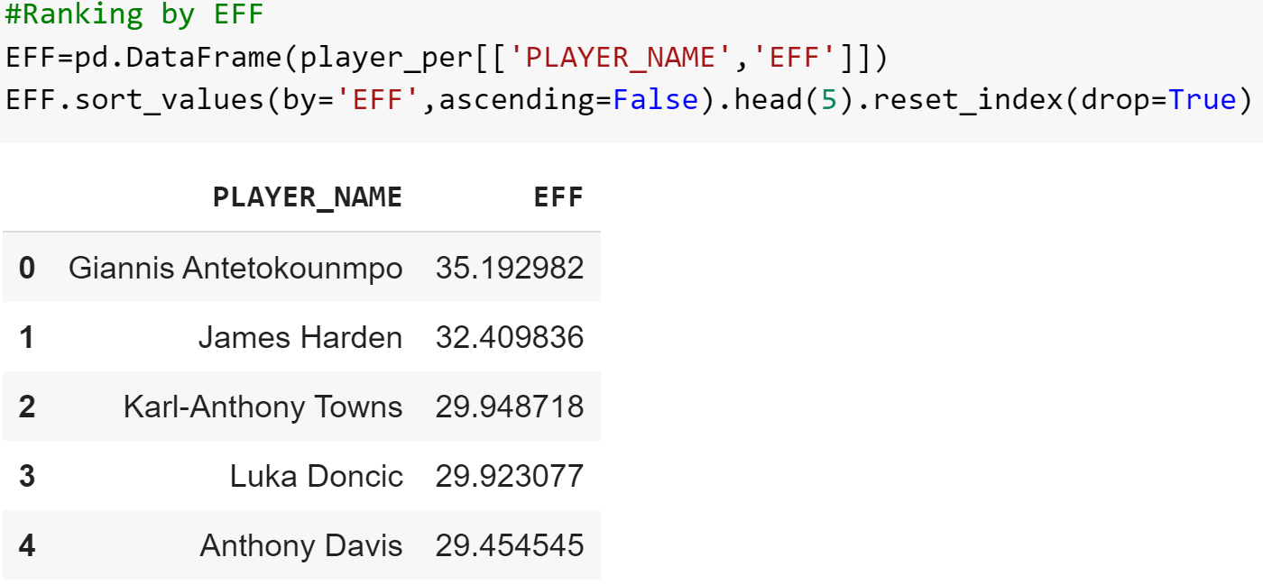
Ranking by EFF

Slide 9
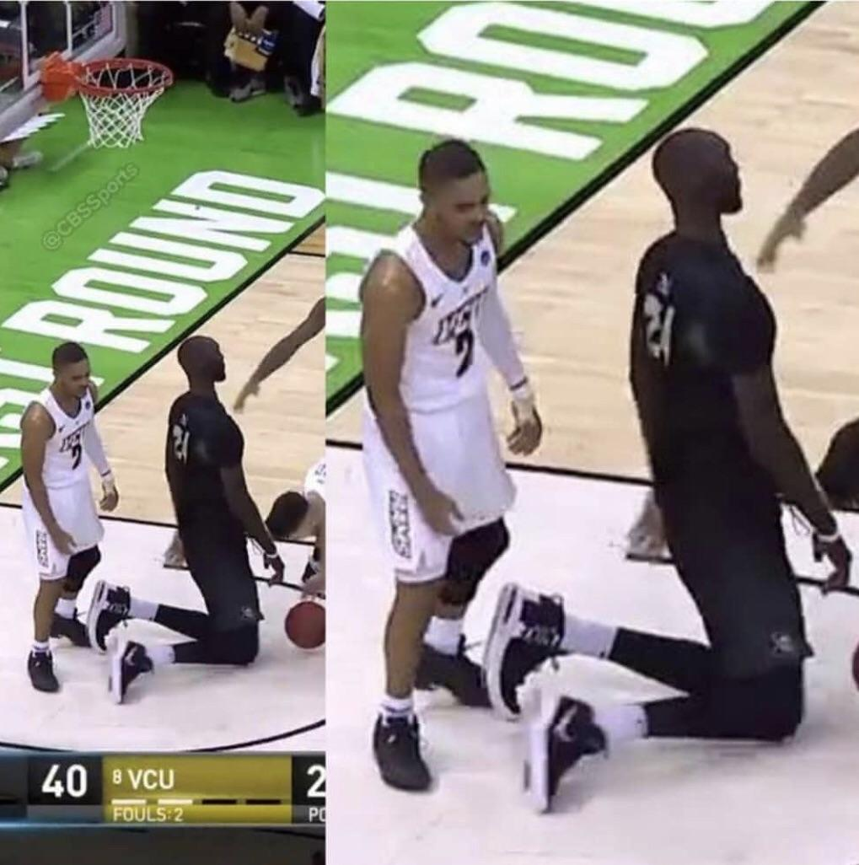
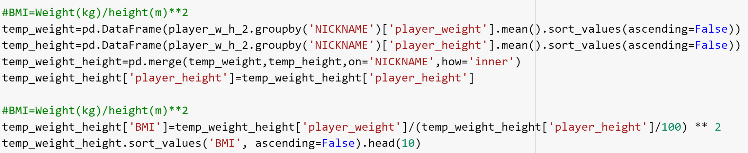
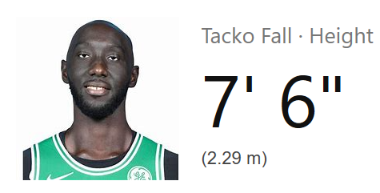
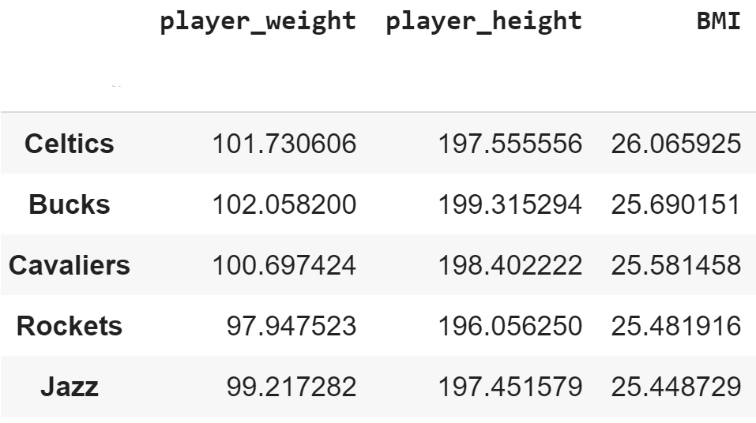
Other information- Body measurements
Average NBA players’ Height: 199 cm
Average NBA players’ Weight: 98.6 kg
Average NBA players’ BMI: 24.92

Slide 10
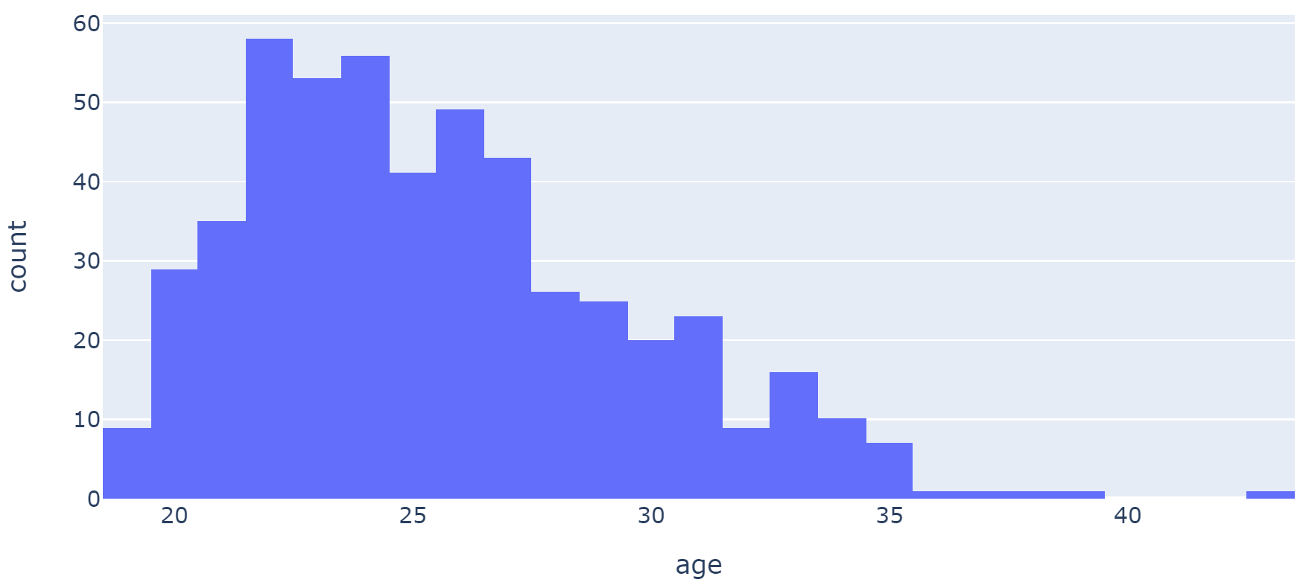
Other information-Age
Average NBA players’ AGE: 25.57
Max: 43
Min:18

Slide 11
Prediction of teams enter playoffs

Slide 12
Analysis: Prediction of teams making playoffs
Only Top 16 teams could enter playoffs
Every regular season has 1,230 games.
Played 900 games, but the rest are cancelled due to epidemic.
Which team will make it to playoffs?
We used regular season performance to predict the outcome.
Histiorical data: Every regular game from 2010-2019 season.
Each team’s performance and each year’s top 16 teams

Slide 13
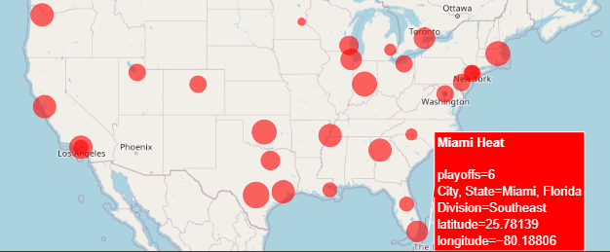
Analysis: Prediction of teams making playoffs
How?
Independent variable = Team performance
Dependent variable = Enter playoffs or not (1, 0)
Figure : Playoffs Counts

Slide 14
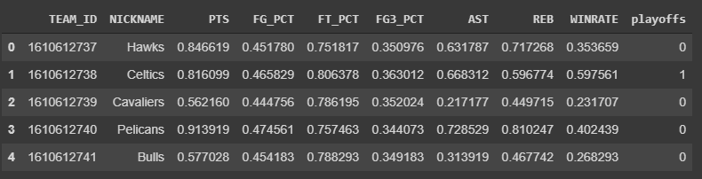
Analysis: Prediction of teams making playoffs
Regular season history data:
games -> all match details from 2010 to 2019
Example: 2018 Regular Season data =
games[(games['GAME_ID'] <= 21801230) & (games['GAME_ID'] >= 21800001)]
Group by teams and add binary variable

Slide 15
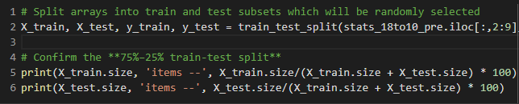

Predicting Model:
Train/Test split:
Logistic Regression: Accuracy -> 0.88235

Slide 16
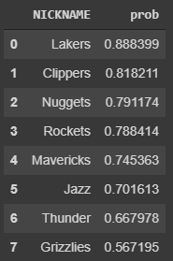
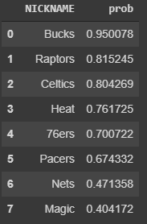
Predicting Result:
Top 8 in West Top 8 in East

Slide 17
Prediction of the Champion Team

Slide 18
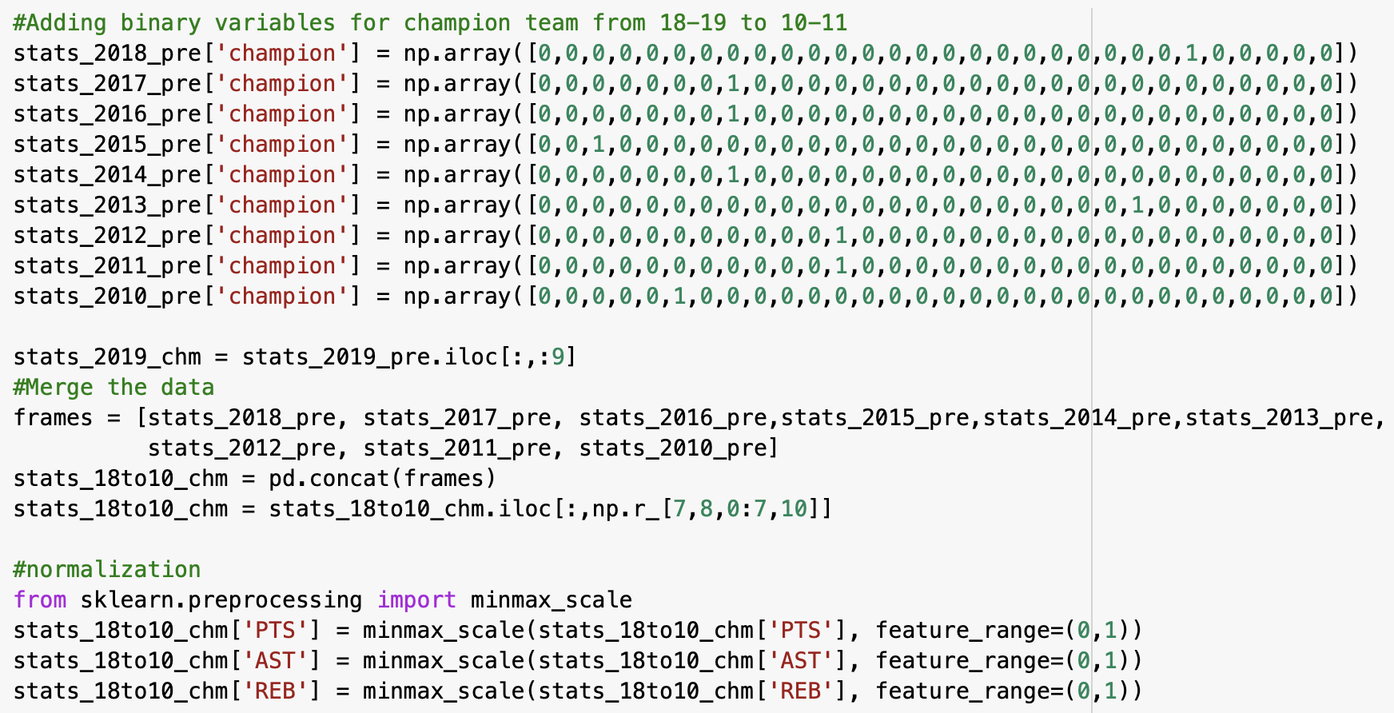
Data

Slide 19
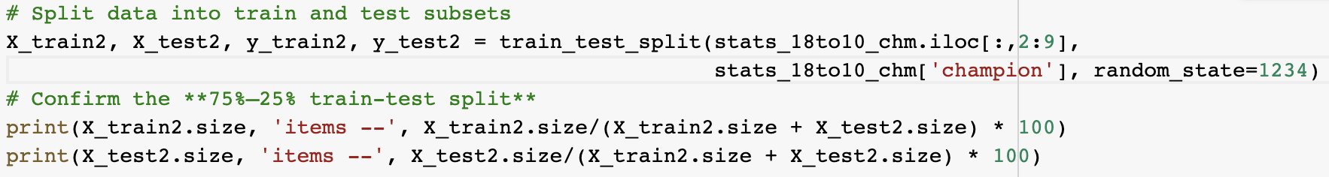
Train/Test Split
Train: 25%, Test: 75%

Slide 20
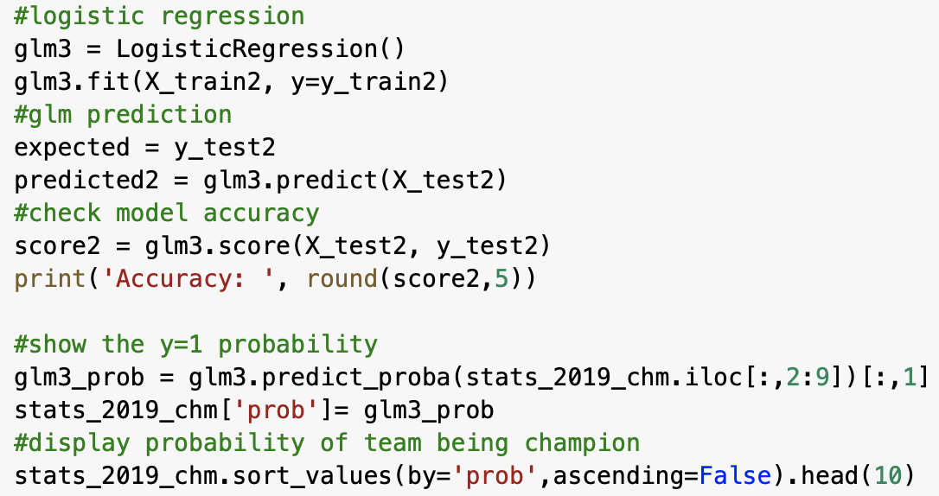
Logistic Regression Model
Accuracy: 0.94118

Slide 21
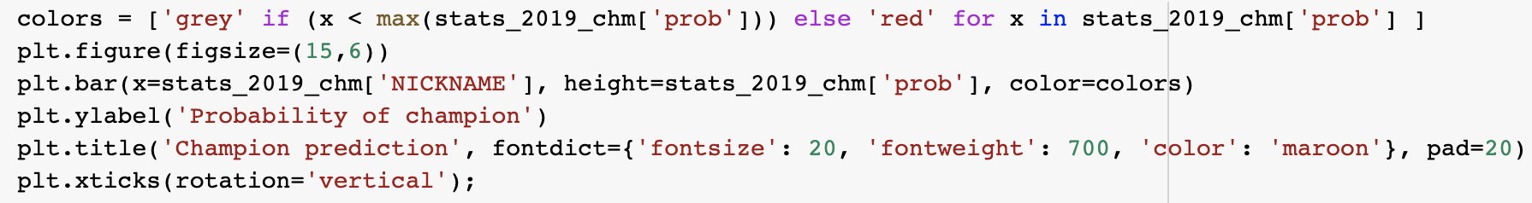
Visualization
Bar Chart

Slide 22
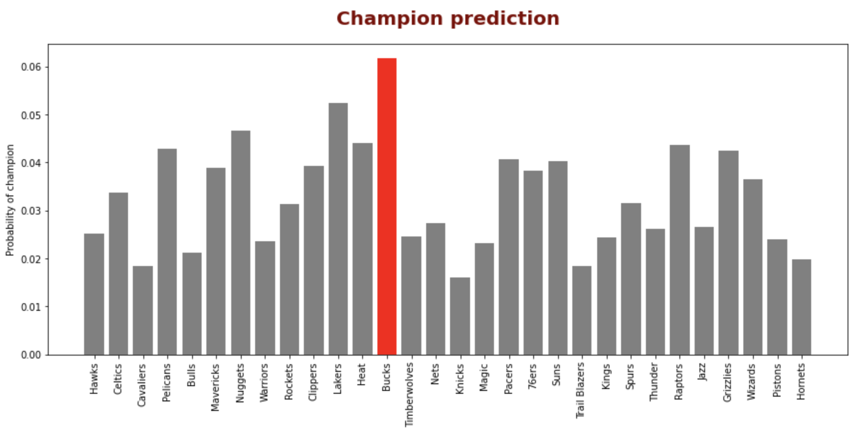

Slide 23
Stay Safe & Thank you for your listening

